Slide 1
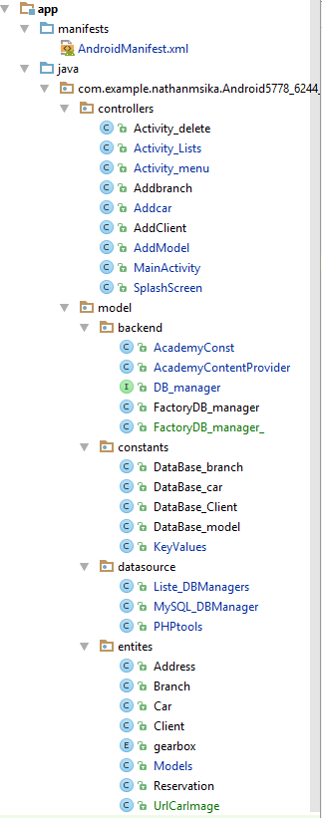
First application Take & Go the Employer
entites | datasource | Constants | Backend | Controllers
Address | The function | Data base client | The content provider | Activity delete
Branch | My sql db | Car | Content value to object | Affichage list
Car |  | Branch | Interface Db_manager | Add branch
Client |  | model | Factory toinstance db_manager | Add client
Gearbox |  |  |  | Add car
Model |  |  |  | Add model
Reservation |  |  |  | Main activity
url image |  |  |  | Splash scress

Slide 2
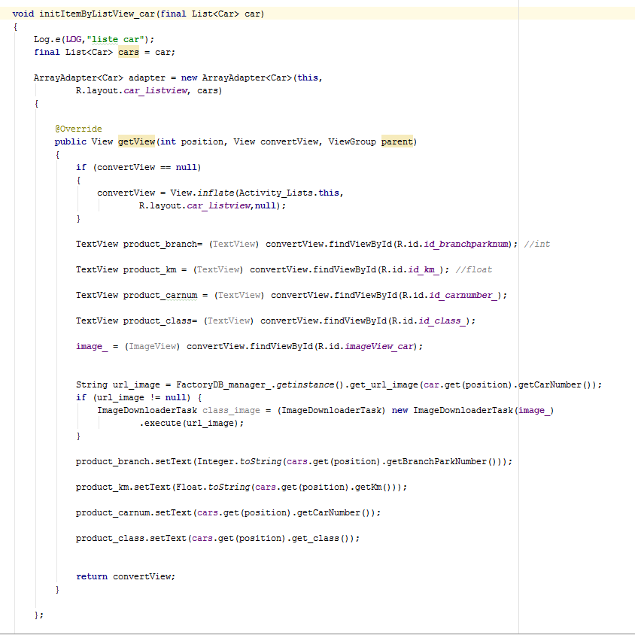
Activity List
L’activite pour afficher une liste
I use a ArrayAdapter<car> and I put in adaptater
To my list view

Slide 3
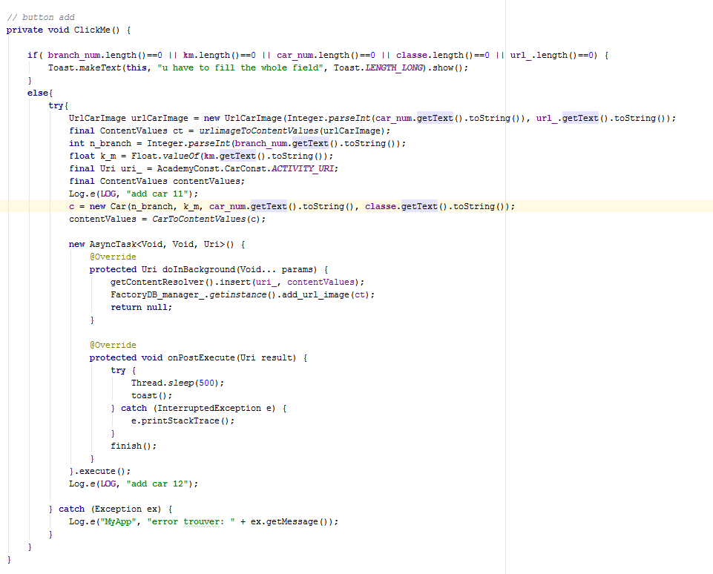
Add Car
I add car to my content provider with Uri
Getcontentrosolver().inset(uri_,contentvales);
Add_url() is to add in server the url of the image of car
I use Async Task

Slide 4
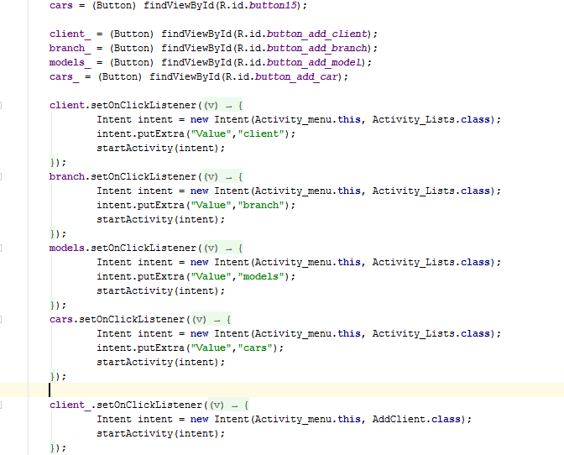
The menu
I transfer the intent to other activity if is list

Slide 5
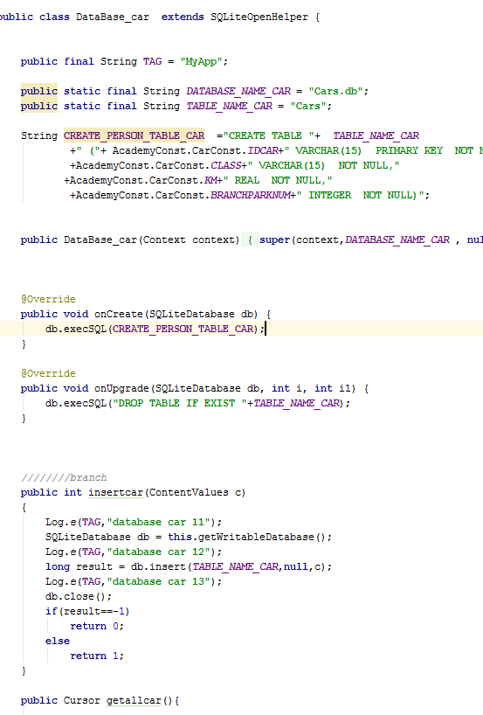
Date Base Car in Sqlliteopenhelper
I made a class to save my object In the phone help in sql

Slide 6
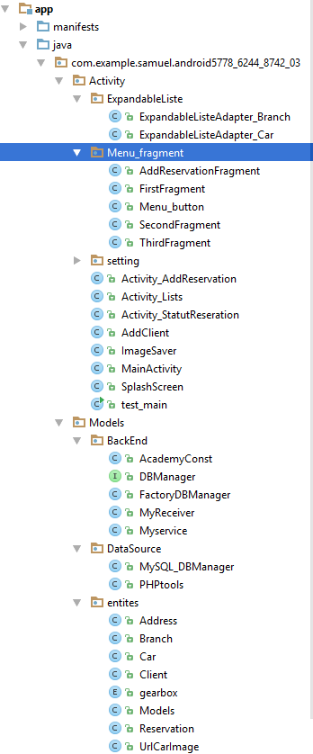
Second Application : the Client

Slide 7
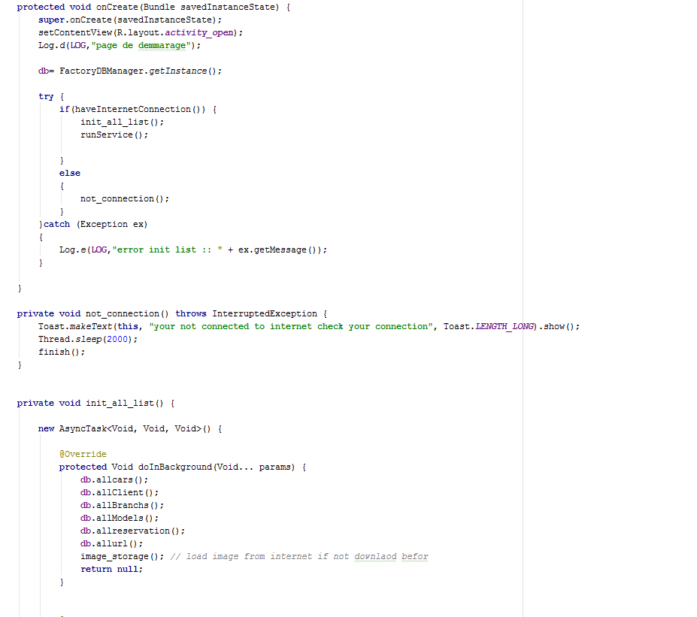
Splash screen
I ma =ke on splash screen befor to enter to my app
Because I want to download before the all list of my My table in my server
And I make all of my image of cars in memory internal

Slide 8
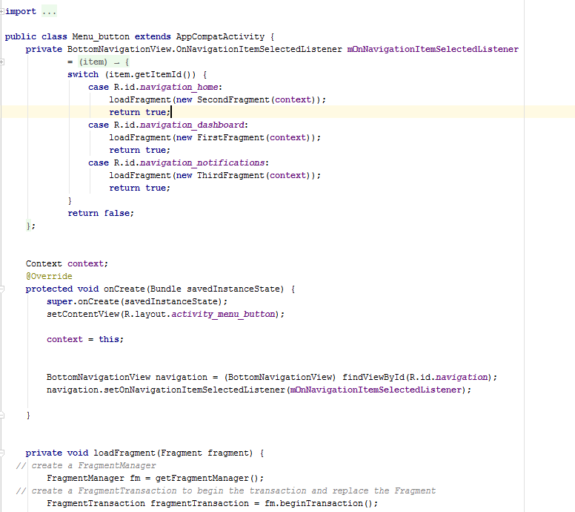
Menu Fragment
I have a menu
if I click I load fragment

Slide 9
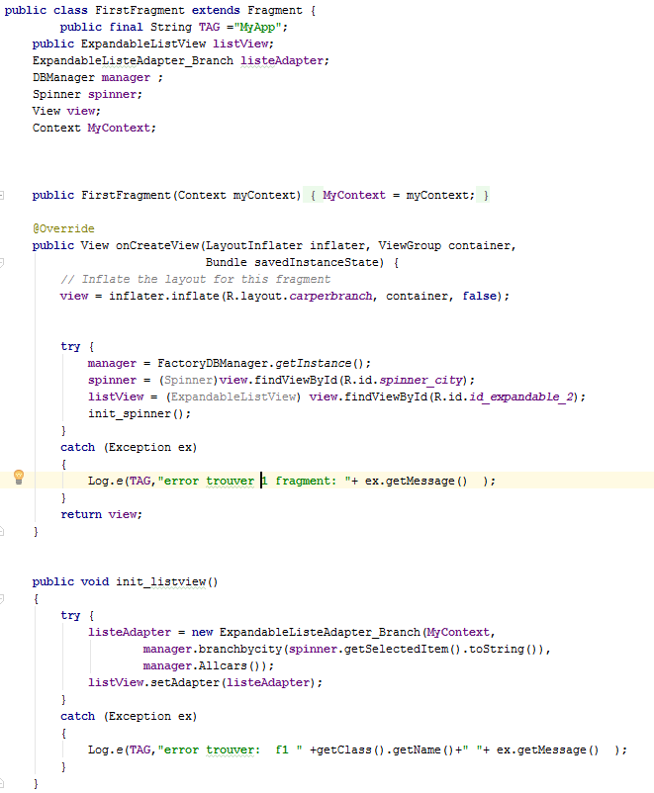
My first fragment
I init the spinner and I init th ebutton and the textview
I saw the expandable list of car

Slide 10
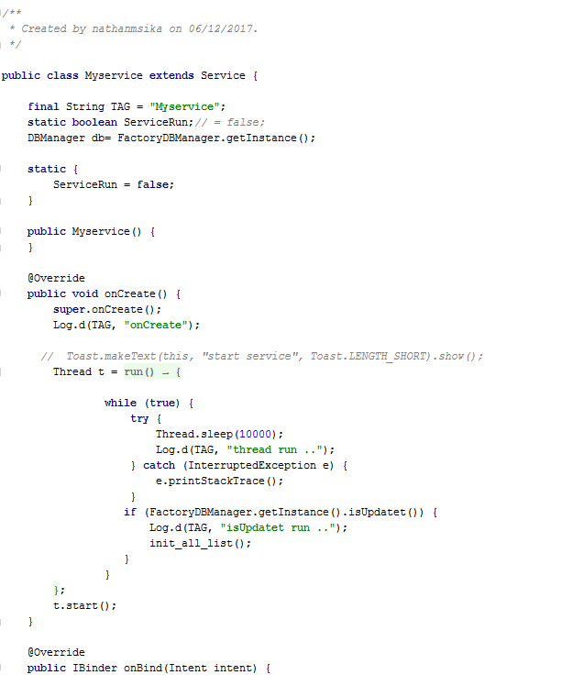
My service
All 10 second I verify if I have any changment in my table if true I init_allist()

Slide 11
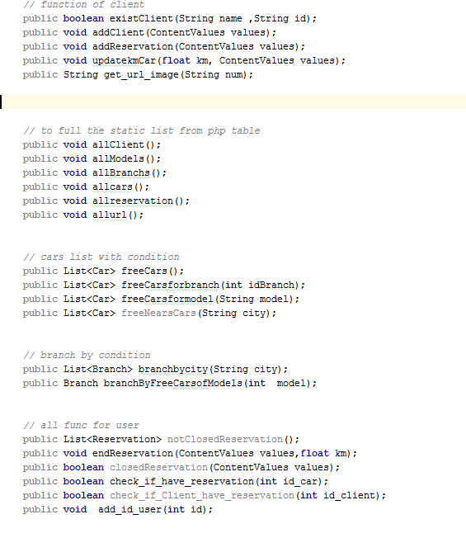
DB manager
All function if my project I use it

